Slide 1
Article 12 of the Michigan Constitution
By: Elijah Bean and Michael Bankowski

Slide 2
Article 12 point1
You can propose amendments to the senate or house of representatives.

Slide 3
Article 12 point 2
If agreed upon by 2/3 of members it can become apart of the constitution at the end of 45 days after it was approved.

Slide 4
Article 12 point3
Amendments may be proposed via petition and all must have full text of proposed amendment, and be signed by registered electors of the state by at least 10% of the voters.

Slide 5
Article 12 point 4
Petitions must be put in 120 days before an election. Also must have an announcement 60 days prior to the election.

Slide 6
Article 12 point 5
The ballot to be used in the election has to have the purpose of the proposed amendment in less than 100 words.

Slide 7
Article 12 point 6
When two or more amendments approved by the voters at the same election, the amendment with the majority of votes will be selected.

Slide 8
Article 12 point 7
Every 16 years you have the option to vote to amend the constitution.

Slide 9
Article 12 point 8
If most of the electors favor an amendment then they can call for a convention. Then there must be an election within 6 months of approval of the amendment.

Slide 10
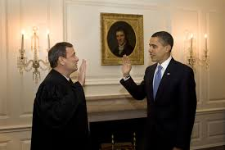
Article 12 point 9
Any amendments proposed to the convention shall be submitted to the qualified electors, and provided to them no less than 90 days after final selection. Upon approval of the convention it shall take effect.

Slide 11
Article 12 point 10
If any part or subsection of Article 2, Section 10, Article 4, Section 54 or Article 5, Section 30is deemed unconstitutional then the remaining sections, subsections of those parts will not be affected but will remain the same and in full effect.

