Slide 1
Bonding Types Virtual Lab
A virtual laboratory experiment to determine the types of bonds found in a substance.
Click to advance this slide!

Slide 2
Bond Types
We have learned that there are three types of bonds. What are these three bond types? Think about it, then click here for the answer.
You can also separate covalent bonds into two types. What are the two types of covalent bonds? Consider it, then click here for the answer.
Done with this slide, click here for the next slide.

Slide 3
Formation of Bonds
Click on each of the following to review the formation of the different bond types.
Ionic
Metallic
Covalent
Click here when you are finished with all three.

Slide 4
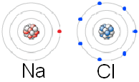
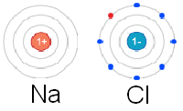
Ionic Bonds – Formation
Before Forming Bond
After Forming Bond
Sodium gives an electron to chlorine.
+1 charge: lost 1 electron
-1 charge: gained 1 electron
Sodium has 1 valence electron to give away.
Chlorine has 7 valence electrons, but it needs 8 to be stable.
By gaining an electron, chlorine now has a full octet and is stable. Since sodium lost an electron, the next lowest energy level is now the valence level. It also has a full octet.
Click here to return.

Slide 5
Metallic Bonds – Formation
Each metal atom gives up it’s valence electrons to the electron sea.
+3
+3
+3
+3
+3
+3
The electrons flow in-between the cations, insulating them, preventing two positive charges from touching each other and repelling.
+3
+3
+3
+3
+3
+3
+3
+3
+3
+3
+3
+3
The valence electrons are constantly attracted to the metal cations; holding the metallic crystal together.
Click here to return.

Slide 6
Covalent Bonds – Formation
Electrons are shared in order to give each atom a full octet.
A molecular compound is formed from covalent bonds.
Cl Cl
Cl–Cl
Shared electron pair
Click here to continue.

Slide 7
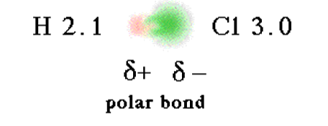
Covalent Bonds – Formation
Polar Bonds
Nonpolar Bonds
One element is more electronegative than the other; pulls electrons harder; unequal sharing
Elements have similar or the same electronegativity; electrons are shared equally.
Click here to return.

Slide 8
Now that we know the bond types…
How do we know that the bonds in a substance are ionic or covalent? Metallic?
Each bond type has different properties:
Ionic
Metallic
Covalent

Slide 9
Ionic Bonds - Properties
Dissolves in a polar solvent. Click here.
Poor conductors as solids, but good conductors when dissolved in water or melted. See it here.
High melting and boiling points. Check here.
Brittle – not malleable. Click here.
Once you are finished, click here.

Slide 10
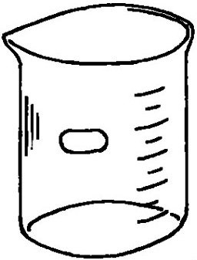
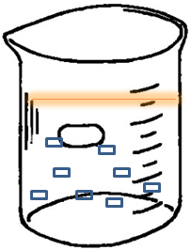
Ionic Dissolving - what will happen?
Your done with this slide. Click here to move on.
Below are two beakers. One has water, and the other has oil. What will happen when I drop some salt (ionic) into the beakers? Click to find out!
WATER – polar solvent
OIL – nonpolar solvent
Click to add salt.
Now, click to see what happens.
The ionic compound dissolves!
The ionic compound cannot dissolve!

Slide 11
Ionic Conducting – what will happen?
We will use a conductivity meter to test if salt (ionic) will conduct electricity.
The lights didn’t turn on! Does this ionic compound conduct electricity?
Salt Crystal
No! Ionic compounds do not conduct electricity when in their solid state.
Test Yourself: What would happen if we dissolved the salt in water? Would it conduct then?

Slide 12
What if we dissolve the salt in water?
Finished! Click here for the next.
When we place the salt in water…
… the salt dissolves; freeing the ions from the crystal lattice structure.
Water
Now, the ions can move freely and the aqueous solution will conduct!
+
-
+
-
+
-
+
-
-
+
-
+
-
+
-
+
+
-
+
-
+
-
+
-
Sodium Chloride Crystal

Slide 13
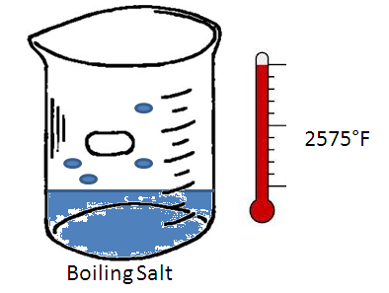
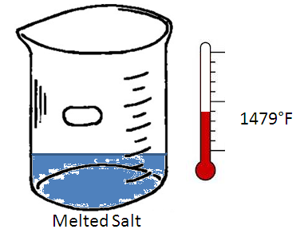
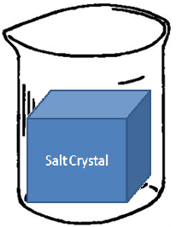
Ionic High Melting and Boiling Points
Click here to continue.
What temperatures do substances with ionic bonds melt and boil at? Click to start heating!
High melting and boiling points.
Heat Source

Slide 14
Ionic Compounds are Brittle
Lets watch what happens when we strike the ionic compound with a hammer.
Hammer
Na⁺
Cl⁻
Na⁺
Cl⁻
Notice that now, like charges are next to each other, a positive is next to a positive, and a negative is next to a negative.
Cl⁻
Na⁺
Cl⁻
Na⁺
Opposites attract; like charges repel.
Na⁺
Cl⁻
Na⁺
Cl⁻
Cl⁻
Na⁺
Cl⁻
Na⁺
This causes the crystal to shatter (due to repulsion of like charges).

Slide 15
Metallic Bonds - Properties
Does not dissolve. Watch it here.
Excellent conductors as solids. (Do not dissolve in water, so they do not conduct as aqueous.) Take a look here .
High melting and boiling points. Click here.
Highly malleable. See it here.
Once you are finished, click here.

Slide 16
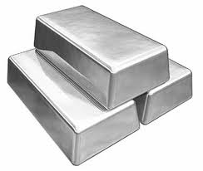
Metallic Dissolving - what will happen?
Click here, your done with this slide.
Below are two beakers. One has water, and the other has oil. What will happen when I drop some silver (metallic) into the beakers? Click to find out!
Because it does not dissolve in water, it cannot form an aqueous solution – does not conduct!
WATER – polar solvent
OIL – nonpolar solvent
Click to add silver.
Now, click to see what happens.
The metallic compound cannot dissolve!
The metallic compound cannot dissolve!

Slide 17
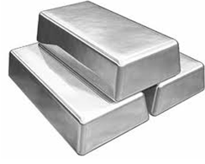
Metallic Conducting – what will happen?
Done! Click here.
We will use a conductivity meter to test if silver will conduct electricity.
The lights turned on! Does this metallic compound conduct electricity?
Yes! Metallic compounds conduct electricity very well.
Test Yourself: How is the good conductance explained by the electron sea model?

Slide 18
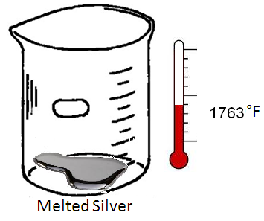
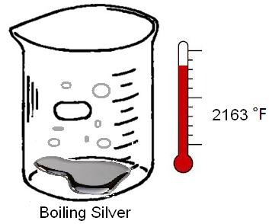
Metallic High Melting and Boiling Points
Click here to continue once finished with this slide.
What temperatures do substances with metallic bonds melt and boil at? Click to start heating!
High melting and boiling points.
Heat Source

Slide 19
Metallic Malleability
Lets watch what happens when we strike the metal with a hammer.
Hammer
Notice that the cations slide past each other; they shifted past each other.
+3
+3
+3
+3
+3
+3
+3
The delocalized electrons are always there, holding together any shifting cations.
+3
+3
+3
+3
+3
+3
+3
+3
The metal is held together due to the constant attraction of the cations to the electron sea.

Slide 20
Covalent Bonds - Properties
Remember: polar and nonpolar!
Polar covalent molecules only dissolve in polar solvents. Nonpolar covalent molecules only dissolve in nonpolar solvents. Watch it here.
Both are poor conductors as solids and as aqueous solution. Take a look here.
Both have low melting and boiling points. Check it out here.
Generally they are not malleable. See it here.
When done, click here.

Slide 21
Covalent Conducting – what will happen?
Finished this slide you have. Here you should click.
We will use a conductivity meter to test if water (polar) and oil (nonpolar) will conduct electricity.
The lights stay off! Do these covalent compounds conduct electricity?
Nope! Believe it or not, pure water does not conduct electricity. Neither does oil.
Test Yourself: What could I add to the water to make it conduct?
WATER – polar
OIL – nonpolar

Slide 22
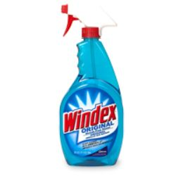
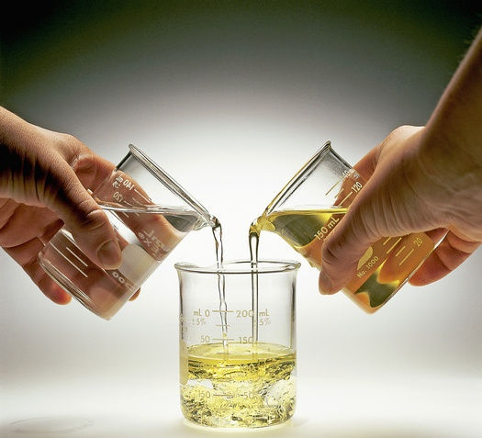
Covalent Dissolving – what will happen?
Click here, this slide is toast.
What happens when you mix water (polar) and oil (nonpolar)?
What happens when you mix water (polar) and ammonia (polar)?
This can be summarized with the phrase “like dissolves like”. In other words, polar dissolves in polar, and nonpolar only dissolves in nonpolar. They can’t mix.
Ammonia (polar) mixes with water (polar). These are the two main ingredients in Windex.
Oil (nonpolar) does not mix with water (polar).

Slide 23
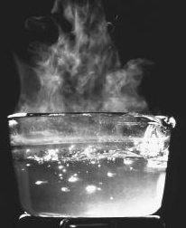
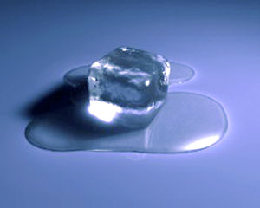
Covalent Low Melting and Boiling Points
Shows almost over. Click here once finished with this slide.
Water melts at 32°F (ice melting into liquid).
Water boils at 212°F.
Low melting and boiling points
32°F
212°F

Slide 24
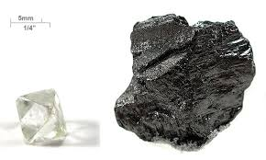
Covalent Malleability
Most covalent compounds are liquids or gases at room temperatures, so they cannot have malleability.
The solid covalent compounds will be brittle
Ice
Carbon compounds (charcoal)

Slide 25
Bond Types
There are three bond types:
Metallic
Ionic
Covalent
Click here to return!

Slide 26
Bond Types
There are two types of covalent bonds:
Polar
Nonpolar
Click here to return!

Slide 27
You might (read: will) see this on an upcoming test.

