Slide 1
“Too many people expect wonders from democracy, when the most wonderful thing of all is just having it” -Walter Winchell
WELCOME TO CONSTITUTION DAY 2009

Slide 2
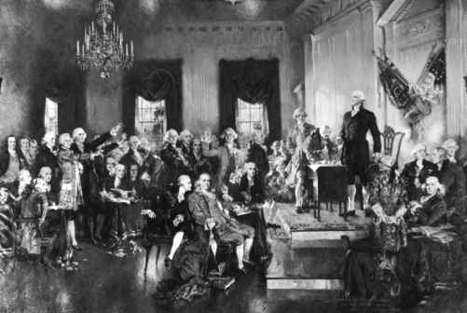
Why constitution day?

Slide 3
Good start!
We hold these truths to be self-evident, that all men are created equal, that they are endowed by their Creator with certain unalienable Rights, that among these are Life, Liberty and the pursuit of Happiness.

Slide 4
D’oh! The articles of confederation
RATIFIED MARCH 1, 1781…..SCRAPPED
SEPTEMBER 17, 1787….WE LEARNED FROM
OUR MISTAKES, UNLIKE HOMER.

Slide 5
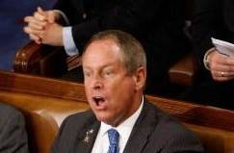
WE’RE FREE….WE MESSED UP…. NOW LET’S ARGUE
Do you think these two are
different? Their comments
and disagreements are small
compared to the FEDERALISTS
and the ANTIFEDERALISTS.
YOU LIE!
This fundamental difference in
philosophy that was there in 1787 is still
at the root of our political differences in 2009.

Slide 6
james madison, father of the constitution
5’4”, 98 pounds….little people can be a big
success in life…

Slide 7
Preamble
We the People of the United States, in Order to form a more perfect Union, establish Justice, insure domestic Tranquility, provide for the common defense, promote the general Welfare, and secure the Blessings of Liberty to ourselves and our Posterity, do ordain and establish this Constitution for the United States of America.

Slide 8
The articles
LEGISLATIVE
EXECUTIVE
JUDICIAL
STATES
AMENDMENTS
DEBTS, SUPREMACY
OATHS
VII. RATIFICATION
THANK YOU, SOCIAL STUDIES DEPT. FOR RIDDING ME OF MY INSOMNIA….

Slide 9
First amendment

Slide 10
second amendment
A well regulated Militia, being necessary to the security of a free State, the right of the people to keep and bear Arms, shall not be infringed.

Slide 11
Third amendment
THEY WERE
SHOOTING AT US, SO THESE LIMEY REDCOATS CERTAINLY ARE NOT GOING TO SPEND THE NIGHT!

Slide 12
FOURTH AMENDMENT
Note: These are the searches that don’t conflict with the 4th Amendment- Border, emergency, administration, consent, hot pursuit, pursuant to the crime scene, probable cause, inventory, secondary searches, security i.e. frisked before entering arena
B E A C H
P P I S S
Notes:
This is a reminder to the warrantless searches that police/govt. officials can perform….border, emergency, administration, consent, hot pursuit, etc.

Slide 13
Fifth amendment
GRAND JURY
DOUBLE JEOPARDY
NO SELF-INCRIMINATION
NOT BE DEPRIVED OF
LIFE, LIBERTY, OR
PROPERTY WITHOUT JUST COMPENSATION
*DUE PROCESS*

Slide 14
SIXTH AMENDMENT
Speedy and public trial
Impartial jury
Be informed of the nature and cause of the accusation
Witnesses
Give an attorney to represent you

Slide 15
Seventh amendment
In Suits at common law, where the value in controversy shall exceed twenty dollars, the right of trial by jury shall be preserved, and no fact tried by a jury, shall be otherwise reexamined in any Court of the United States, than according to the rules of the common law.

Slide 16
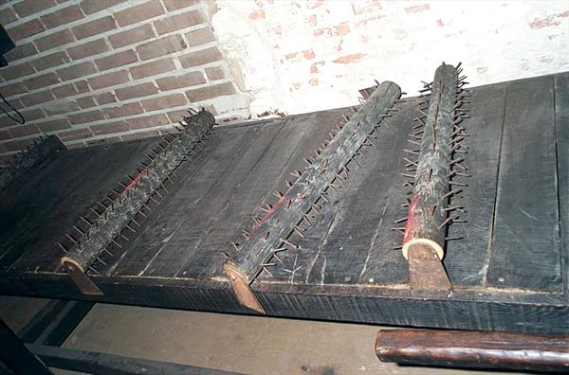
Eighth amendment
Not in America!

Slide 17
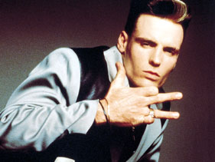
Ninth amendment
In the Federalist Papers #84 Alexander Hamilton asked,
"Why declare that things shall not be done which there is no power to do?“
Word to your mother
****Was done as check and balance of Article I Section 8 to prevent the Legislative Branch from getting too much power*****

Slide 18
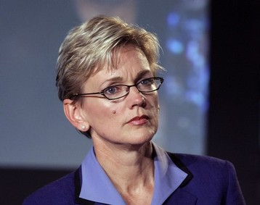
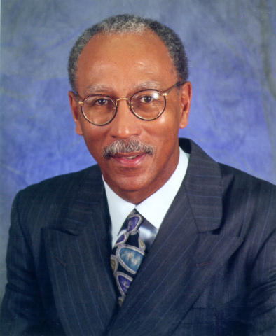
Tenth amendment
POWER RESIDES AT VARIOUS
LEVELS OF GOVERNMENT

Slide 19
Interesting facts
THE CONSTITUTION ONLY CONTAINS 4,440 WORDS.
ALL THE DELEGATES NEVER WERE TOGETHER IN THEIR ENTIRETY.
BENJAMIN FRANKLIN WAS THE OLDEST PERSON TO SIGN IT AT 81 YEARS OLD, JONATHAN DAYTON THE YOUNGEST AT 26.

Slide 20
MORE INTERESTING FACTS
BENJAMIN FRANKLIN WAS SO OLD HE NEEDED HELP SIGNING AS TEARS STREAMED DOWN HIS FACE.
GEORGE WASHINGTON PROCLAIMED THE FIRST THANKSGIVING ON 11.26.1789 TO GIVE “THANKS” FOR THE CONSTITUTION.

Slide 21
MORE INTERESTING FACTS
THE WORD, “DEMOCRACY” DOES NOT APPEAR ONCE IN THE CONSTITUTION
IT TOOK EXACTLY 100 DAYS TO FRAME THE CONSTITUTION
A MAN NAMED JACOB SHALLUS WAS HIRED TO WRITE THE FINAL COPY OF THE CONSTITUTION. HE WAS PAID $30 ($661.29 TODAY)

Slide 22
AMENDMENTS PROPOSED BUT NOT RATIFIED
1876- AN ATTEMPT TO ABOLISH THE U.S. SENATE
1876- FORBIDDING RELIGIOUS LEADERS FROM HOLDING ANY GOVERNMENT JOB OR RECEIVING ANY FEDERAL MONEY

Slide 23
AMENDMENTS PROPOSED BUT NOT RATIFIED 2
1878- GETTING RID OF ONE PRESIDENT IN FAVOR OF THREE.
1893- RENAMING THIS NATION, “UNITED STATES OF THE EARTH”
1893- ABOLISHING THE ARMY AND NAVY

Slide 24
AMENDMENTS PROPOSED BUT NOT RATIFIED 3
1894- ACKNOWLEDGEMENT THAT THE CONSTITUTION SHOULD RECOGNIZE GOD AND JESUS CHRIST AS THE SUPREME AUTHORITIES IN HUMAN AFFAIRS.
1912- MARRIAGE BETWEEN THE RACES SHOULD BE ILLEGAL.

Slide 25
AMENDMENTS PROPOSED BUT NOT RATIFIED 4
1914- MAKING DIVORCE ILLEGAL
1916- ALL ACTS OF WAR PUT TO A NATIONAL VOTE
1933- WEALTH CAN BE LIMITED TO ONLY $1,000,000
1936- AGAIN, TO PUT ALL WAR TO A VOTE FROM THE PEOPLE.

Slide 26
AMENDMENTS PROPOSED BUT NOT RATIFIED 5
1938-FORBIDDING ALL DRUNKENESS
1947- THE INCOME TAX CAN NEVER GO HIGHER THAN 25%
1948- RIGHT TO SEGREGATE OURSELVES
1971- AMERICAN CITIZENS SHOULD BE FREE FROM POLLUTION.

Slide 27
AGAIN, WHY CONSTITUTION DAY?
A WORD FROM YOUR SOCIALSTUDIES DEPARTMENT….
THANKS FOR YOUR ATTENTION AND BE THANKFUL THAT YOU’RE AMERICANS, THERE IS NO BETTER PLACE ON EARTH.
BE RESPONSIBLE, BE RESPECTFUL, BE SAFE.

