Slide 2
Discrepancies in Historical Understanding of Pearl Harbor
The United States:
An act of treachery
Part of a deep-seated “conspiracy against peace”
Japan
A tactical blunder
An ill-conceived response to a collapsing world order

Slide 3
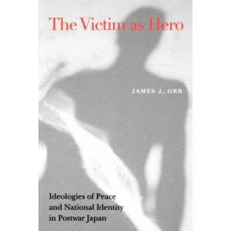
Setting Aside dominant national views…

Slide 4
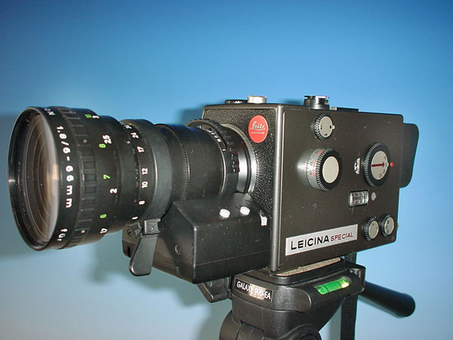
Historical Perspectives- “Parachutists and Truffle Hunters”
1. Close-up views
2. Mid-range views
3. Distant panoramas

Slide 5
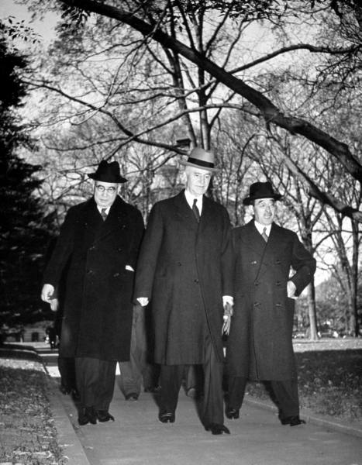
1. Close-up: Last minute failures of diplomacy and political decision-making
Diplomatic Talks (March-November 1941)
Nomura Hull, U.S. Secretary of State
Nomura Kichisaburô, Japan’s Ambassador to the U.S.
Kurusu Saburô, career diplomat & special envoy to Washington

Slide 6
Irresolvable Differences?
United States
Moved by moral idealism
Mobilized by threat of “virulent, authoritarian nationalism”
Hull’s “Four Principles” moral idealism
Demanded Japan’s full withdrawal from China
Japan
Seeking practical solutions to the “China Problem”
Supplying Japanese troops
Cutting off aid to Chinese Nationalists
Offered incremental compromise
Left Japan’s hegemony in China intact
From the outset, […] the Americans were as unresponsive to Japanese overtures as the Japanese were uncomprehending of American goals.
--From Peter Duus, Modern Japan (Houghton Mifflin, 1998)

Slide 7
“The Hull Memo”: Four Points
1. Respect for the territorial integrity and the sovereignty of each and all nations.
2. Support of the principle of non-interference in the internal affairs of other countries.
3. Support of the principle of equality, including equality of commercial opportunity.
4. Non-disturbance of the status quo in the Pacific except as the status quo may be altered by peaceful means.

Slide 8
2. Mid-range views: Intensifying U.S.-Japan Conflict, 1937-1941
Japan’s expanding war in China
U.S. economic sanctions against Japan (1938-1941)
Japan’s vulnerability

Slide 9
Imperial Powers and Spheres of Influence in China

Slide 10
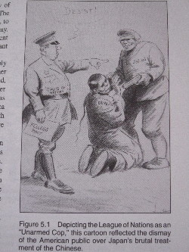
Two forms of imperialism in China? Cooperative Imperialism versus autonomous empire
U.S. “Open door” policy
Japan’s claims of “special interests”
“Manchurian Incident” 1931

Slide 11
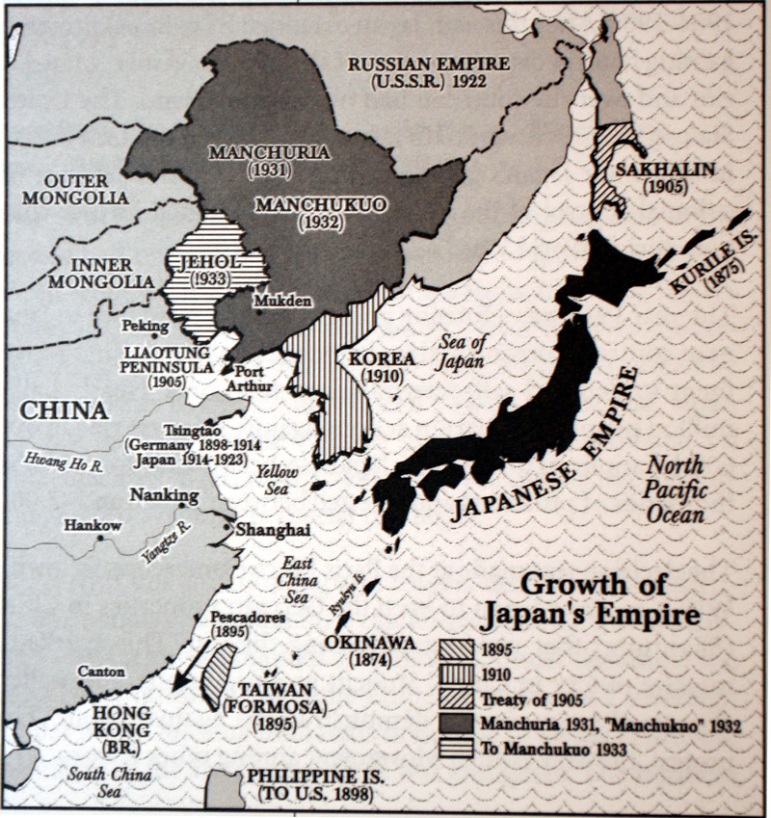
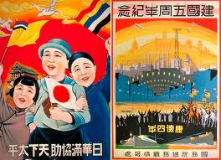
Japan’s Invasion and Occupation of “Manchuria”
Japanese troops march into Shengyang
Japan invasion of Manchuria, 1931

Slide 12
Japan’s Incremental Occupation of China

Slide 13
“The China Incident” 1937 (aka “The Second Sino-Japanese War”)
Chiang Kai-shek declares
a “policy of resistance”
against the Japanese
General Iwane Matsui
enters Nanking (Nanjing),
December 1937

Slide 15
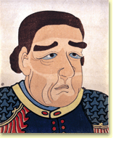
3. Distant Panorama: “Opening” of Japan
America’s “Manifest Destiny” extends into the Pacific
Commodore Matthew C. Perry (U.S. Navy): a message backed by force
“Unequal Treaties”
Intensification of Japan’s internal crisis
Which portrait best captures Perry’s likeness?

Slide 16
Monstrous “Black Ships” or Vanguard of Civilization?
“U.S. JAPAN FLEET. Com. PERRY carrying
the ‘GOSPEL of GOD’ to the HEATHEN,
1853” by James G. Evans, oil on canvas
Image from MIT “Visualizing Culture” website: http://ocw.mit.edu/ans7870/21f/21f.027/home/index.html

Slide 17
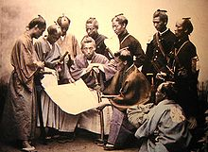
Japan on the verge of the Meiji Revolution
Satsuma samurai plotting strategy
against the Tokugawa Bakufu

Slide 18
The West as model . . . and threat
Iwakura Mission to Europe & U.S. (1871-73)
“. . . to discover the great principles which are to be our guide in the future”
“Most of the countries in Europe shine with the light of civilization and abound in wealth and power. Their trade is prosperous, their technology is superior, and they greatly enjoy the pleasures and comforts of life”
Foreign experts come to Japan
Study tours to the West
“Civilization and Enlightenment”
Iwakura Mission members including Iwakura Tomomi,
Okubo Toshimichi,
Kido Koin

Slide 19
“New Imperialism” of the Late 19th C.
Backed by industrial power
Intense competition for empire, formal & informal
Supported by new national publics
Measure of international prestige & power

Slide 20
Japan’s Logic of Empire
Prime Minister Yamagata’s policy statement in Japan’s first Diet session (1890):
If we wish to maintain the nations independence among the powers of the world […], it is not enough to guard only the line of sovereignty; we must also defend the line of advantage.
Yamagata Aritomo
1838-1922

Slide 21
Two Imperial Wars: Territorial Expansion
Sino-Japanese War 1894-95
Taiwan/Pescadores
Liaodong Peninsula (retroceded)
Russo-Japanese War (1904-1905)
Southern Sakhalin (Karafuto)
Liaodong Peninsula
“Paramount interest” in Korea

Slide 22
Some Motifs in Japan’s Modern History
“State-of-siege” mentality
Quest for parity with western nations
Focus on injuries to national prestige and power
Diffuse and fragmented political structure

Slide 23
At an Imperial Conference on Nov. 5, 1941. . .
How can we let the United States continue to do as it pleases, even though there is some uneasiness. Two years from now, we will have no petroleum for military use; ships will stop moving, When I think about the strengthening of American defenses in the southwestern Pacific, the expansion of the U.S. fleet, the unfinished China Incident, and so on, I see no end of difficulties. We can talk about suffering and austerity, but can our people endure such a life for long . . . I fear that we would become a third-class nation after two or three years if we merely sat tight.
Tojo Hideki

Slide 24
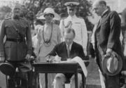
“Yellow Peril” in America: Rhetoric, Image, Act
Coolidge signs Immigration Act of 1924
Chinese Exclusion Act, 1882

Slide 25
HIROSHIMA AND NAGASAKI

Slide 26
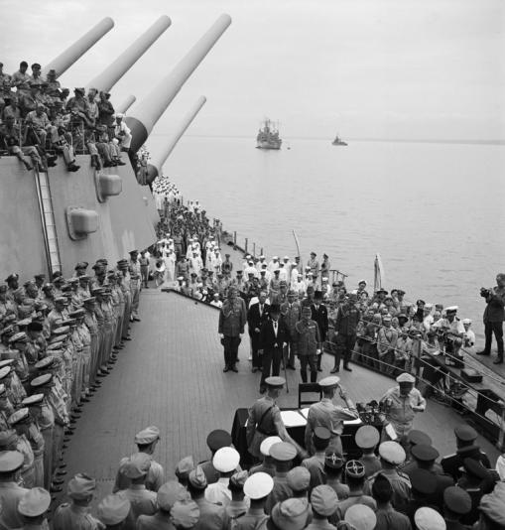
Japanese Surrender aboard the USS Missouri, Sept. 2, 1945

Slide 27
TO SUM UP…..
1) EXPLAIN WHY PEARL HARBOR HAPPENED USING THREE HISTORICAL PERSPECTIVES OF SCALE.
2) ATTEMPTING TO LOSE HISTORICAL BIAS, HOW WOULD YOU DESCRIBE PEARL HARBOR IN A MANNER BOTH AMERICAN AND JAPANESE STUDENTS WOULD AGREE WITH.

