Slide 1
Michigan Constitution
Article I
Karl Hansknecht

Slide 2
Section 1
The government is created for the peoples’ equal benefit, security and protection.
All power of the government only exists because the people let it exist. Without the people, there is no government.

Slide 3
Section 2
Every person has equal protection from the laws.
No one shall be denied his or her political rights or be discriminated based upon religion, race, color, or national origin.

Slide 4
Section 3
The people have the right to come together to discuss what is for the common good and take it to their representatives to have the government take another look at it.

Slide 5
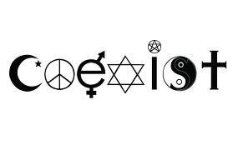
Section 4
No one is required to worship a god, nor will anyone receive or be denied any rights based upon religious beliefs
No government money shall be used to benefit any religious sect or society

Slide 6
Section 5
All people can freely speak, write, express and publish any view on any subject.
No law can restrict this right from anyone.

Slide 7
Section 6
Every person is allowed to keep and bear arms for defense of himself and the state

Slide 8
Section 7
The military is in strict subordination to the civil powers

Slide 9
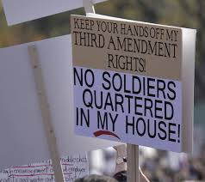
Section 8
No soldiers are allowed to stay in anyone’s home without their consent first, during war or not.

Slide 10
Section 9
Slavery and involuntary servitude, unless being punished for a crime by law, is not tolerable.

Slide 11
Section 10
No laws shall be made to change the punishment of a crime after the crime has been committed

